Slide 1
How BMO accomplished one of the largest North American banking acquisitions: A deep dive into Analytics Delivery

Slide 2
Top 5 North America M&A Deals*
A Deep Dive into Analytics Delivery Behind one of the Largest North American Banking Acquisition
Announcement Date | Target | Buyer | Seller | Transaction Value ($M)
2/7/2019 | SunTrust Banks, Inc. | BB&T Corporation | NA | 31,289.61
12/20/2021 | Bank of the West | BMO Bank National Association | BNP Paribas SA | 13,800.00
11/16/2020 | BBVA USA Bancshares, Inc. | PNC Financial Services Group, Inc. | Banco Bilbao Vizcaya Argentaria, SA | 11,566.74
11/29/2022 | HSBC Bank Canada | Royal Bank of Canada | HSBC Holdings plc | 10,038.22
6/16/2011 | ING Bank, FSB | Capital One Financial Corporation | ING Group N.V. | 8,984.04
*As of 2/7/2024, S&P Global Market Intelligence utilizing US and CAD banks trading on the Nasdaq, NYSE or NYSE American, excluding private equity deals, and deals with a closing date prior to 2010.

Slide 3

16 Billion Dollars
Total deal value when purchasing BotW from BNP Paribas
+2M Customers
New Customers welcomed through conversion
BMO & Bank of the West Deal
+1.8M Accounts
Deal Summary by the numbers
Accounts converted across business
549
Total Number of Branches across USA as of 2021
+$60B Deposits
Deposits converted across core platforms
Total Number of Branches across USA as of 2024
+500 Branches
1,014
Branches and ATMs re-branded and integrated to BMO
*Strategist of the Year: How BMO CEO Darryl White pulled off the biggest bank deal in Bay Street history - The Globe and Mail
*Data sourced from S&P Global Market Intelligence as of 2/7/2024.

Slide 4

Cross Domain Module
An integrated avionic system, with modules inter-connected, offering panoramic views and insights of the vast M&A skies.
Schedule Module
Your flight radar for dynamic scheduling, ensuring timely arrivals and departures in the M&A airspace.
Testing Module
BMO’s 787 Specs
Pre-flight checks across all integrated banking systems, ensuring safe takeoffs and landings.
Exploring the cockpit of this monumental merger: an advanced Power BI application, fine-tuned using just Microsoft Power Platform.
Financials Module
A bird's-eye view of financial expenditure across teams, crucial for plotting the most efficient flight path (synergies) post-acquisition.
Playbook Module
Your flight manual for the pivotal merger weekend, directing the aircraft safely through potential storms.
Social Media Module
An inflight communication channel capturing real-time customer feedback post-merger, ensuring a passenger-first approach.

Slide 5


Cross Domain Framework
Cross-Domain Framework: An integrated avionic system, with modules inter-connected, offering panoramic views and insights of the vast M&A skies.
Granularity
SDLC
Releases
Work Type
Total
Trait 5
Object
Application
20
Granularity
Domain
5
LOB
Total
4

Slide 6




% Completion
Actual % Completion
Expected % Completion
Schedule
Work Status (Traffic Light)
Completed (Blue), In Progress (Green), At Risk (Yellow), Late (Red), Not Started (Grey)
Near Real-Time Schedule Interface: Your flight radar for dynamic scheduling, ensuring timely arrivals and departures in the M&A airspace.
Finish Date
Actual Finish
Expected Finish
Notes:
Include Stats on MPPs (# files, # tasks)

Slide 7
SDLC
Releases
Work Type
Total
Trait 5
Object (Task)
Schedule
App
Near Real-Time Schedule Interface: Your flight radar for dynamic scheduling, ensuring timely arrivals and departures in the M&A airspace.
Domain
LOB
Total
% Completion
Work Status
Finish Date
Notes:
Add the 20 possibilities into the slide

Slide 8
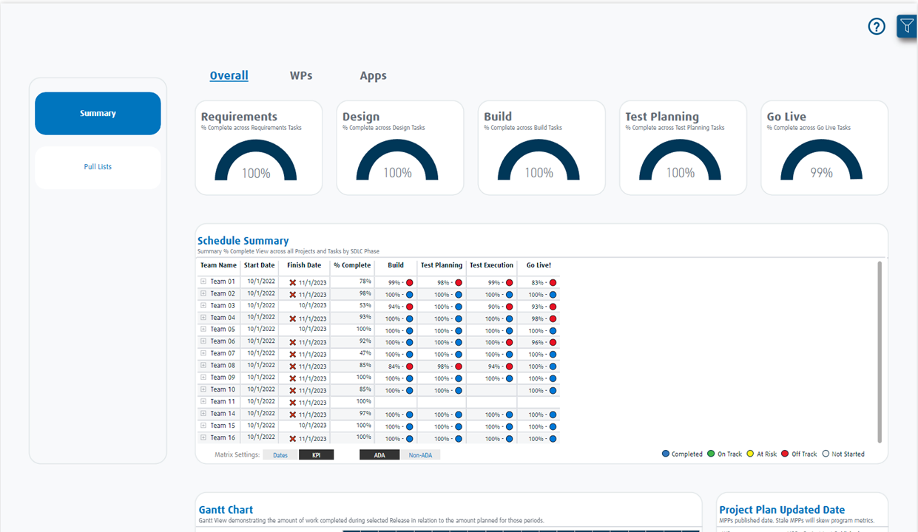
In the interest of clarity and confidentiality, the data presented herein is entirely fictitious and utilized solely for demonstration purposes
Notes:
Add the green, yellow

Slide 9
Schedule Model Design
Near Real-Time Schedule Interface: Your flight radar for dynamic scheduling, ensuring timely arrivals and departures in the M&A airspace.
Schedule Report
Import Mode
Stakeholders
Email Notifications
Microsoft Project Files (PWA)
PBI Dataset
End Users
Notes:
Add the green, yellow

Slide 10
Microsoft Learn: Connect to Project Online with Power BI - Power BI
Schedule
Microsoft Learn: Add or edit enterprise custom fields in Project Server - Project Server
Near Real-Time Schedule Interface: Your flight radar for dynamic scheduling, ensuring timely arrivals and departures in the M&A airspace.
Microsoft Learn: Create or update a baseline or an interim plan in Project desktop
Microsoft Learn: Project Online - Connectors

Slide 11





Test Cases
Executed
Passed
Failed
Bugs/Defects
Testing
Open
Closed
Re-Opened
Comprehensive Testing Analysis: Pre-flight checks across all integrated banking systems, ensuring safe takeoffs and landings.
Velocity (Derivatives)
Open Velocity
Closed Velocity
Open x Closed
Data Quality Related
Orphanage (Test Cases, Bugs, Req)
SLA Breach
Tests not scheduled, missing req, no evidence/attachment.

Slide 12
SDLC
Releases
Work Type
Total
Trait 5
Object (Test/Bug/Req)
Testing
App
Comprehensive Testing Analysis: Pre-flight checks across all integrated banking systems, ensuring safe takeoffs and landings.
Domain
LOB
Total
Test Cases
Bugs Defects
Velocity (Derivatives)
Data Quality

Slide 13
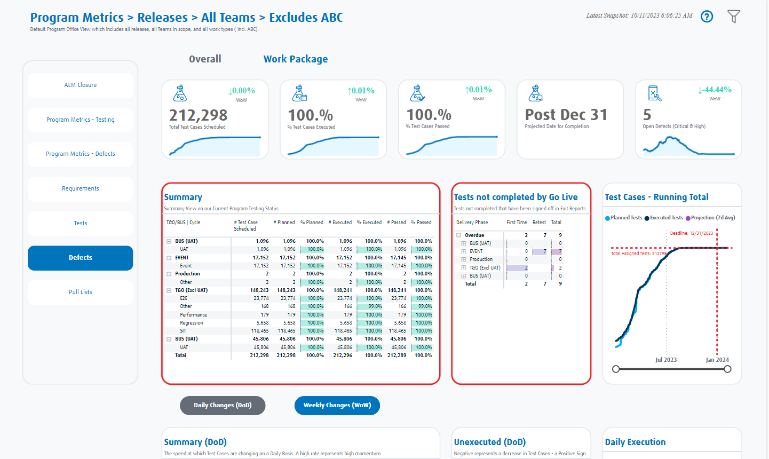
In the interest of clarity and confidentiality, the data presented herein is entirely fictitious and utilized solely for demonstration purposes

Slide 14

Testing Model Design
Comprehensive Testing Analysis: Pre-flight checks across all integrated banking systems, ensuring safe takeoffs and landings.
ALM Report
Stakeholders
Import Mode
Email Notifications
ALM App
Excel Files in SharePoint Folder
PBI Dataset
End Users
Notes:
Add the green, yellow

Slide 15
Youtube: Handling Multiple Fact Tables in Power BI
Testing
ALM Architecture: Introduction
Comprehensive Testing Analysis: Pre-flight checks across all integrated banking systems, ensuring safe takeoffs and landings.
Book: Data Modeling - Alberto and Marco
Microsoft Learn: Power BI Custom Connector: TripPin

Slide 16





Forecast
Actuals
Balance of Year
Forecast Accuracy
Financials
Budget
Budget Utilization
Projections
Industry x Expected Spend
Financial Spend Analysis: A bird's-eye view of financial expenditure across teams, crucial for plotting the most efficient flight path (synergies) post-acquisition.
Resource
Resource Utilization
Resource Rates
Spend by Roles
Resource Counts (FTE Growth)
Overtime

Slide 17
SDLC
Releases
Work Type
Total
Trait 5
Object (T. Class)
Financials
App
Financial Spend Analysis: A bird's-eye view of financial expenditure across teams, crucial for plotting the most efficient flight path (synergies) post-acquisition.
Domain
LOB
Total
Forecast
Budget
Resource

Slide 18
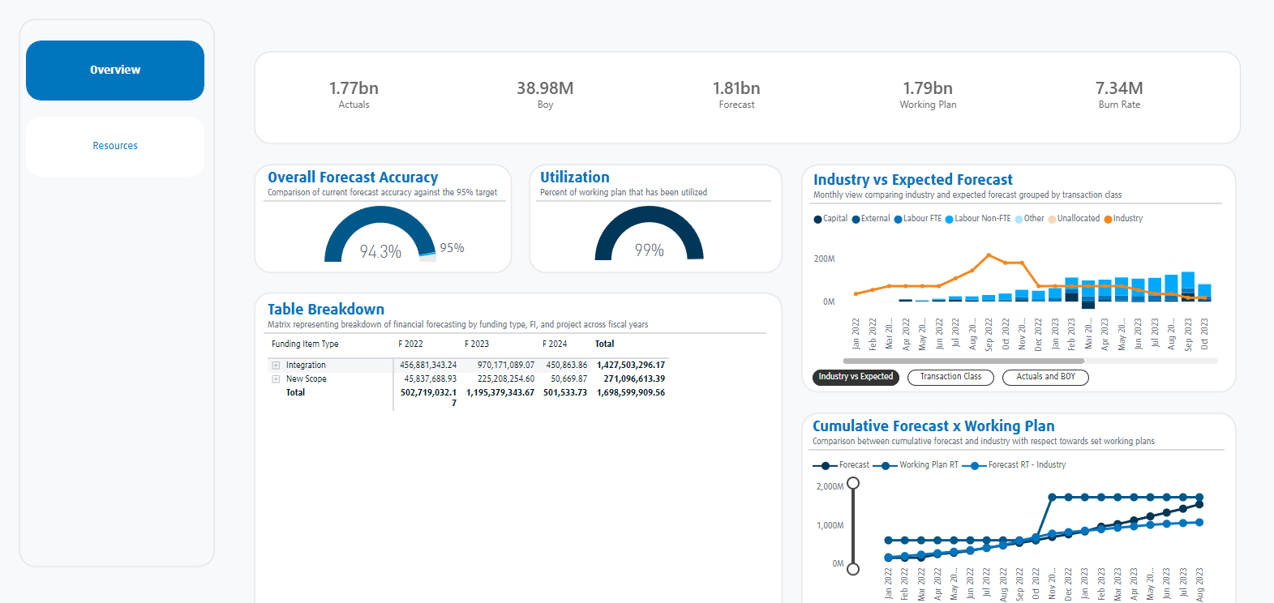
In the interest of clarity and confidentiality, the data presented herein is entirely fictitious and utilized solely for demonstration purposes

Slide 19
Financial Model Design
Financial Spend Analysis: A bird's-eye view of financial expenditure across teams, crucial for plotting the most efficient flight path (synergies) post-acquisition.
Financials Report
Import Mode
Datalake
PBI Dataset
Notes:
Add the green, yellow

Slide 20
DAX Patterns: Budget
Financials
Financial Spend Analysis: A bird's-eye view of financial expenditure across teams, crucial for plotting the most efficient flight path (synergies) post-acquisition.
DAX Patterns: Semi-additive calculations
Microsoft Learn: Use composite models in Power BI Desktop - Power BI

Slide 21



% Completion
Planned
Actual
Completed Today
Playbook
RAIDs
Critical and High RAIDs
Task Impact
Playbook View with Critical Path: Your flight manual for the pivotal merger weekend, directing the aircraft safely through potential storms.
Critical Path
Real Time ‘Floor Mat’ Hours Ahead/Behind
Checkpoints
Overdue/Late Starts

Slide 22
SDLC
Releases
Work Type
Total
Trait 5
Object (Task)
Playbook
App
Playbook View with Critical Path: Your flight manual for the pivotal merger weekend, directing the aircraft safely through potential storms.
Domain
LOB
Total
% Completion
RAIDs
Critical Path

Slide 23
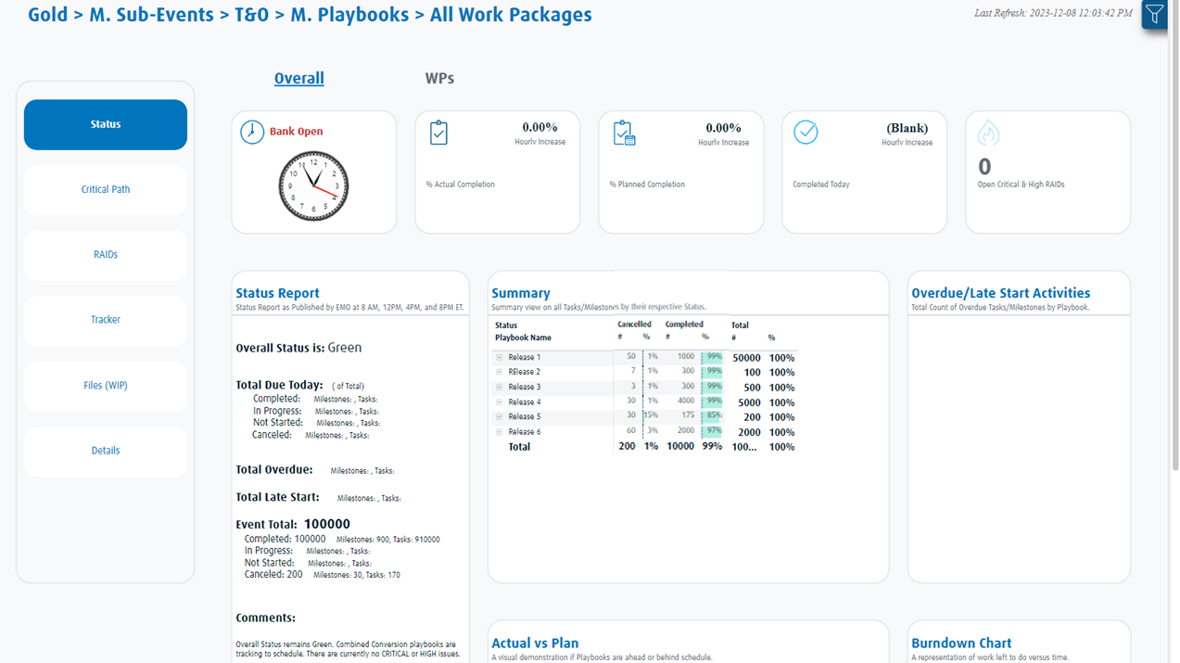
In the interest of clarity and confidentiality, the data presented herein is entirely fictitious and utilized solely for demonstration purposes
Notes:
Two ways to present the data, for illustrative purposes we wanted to simplify and help you visualize all the different categories that can be tracked. Keep in mind all those visuals are not blank but are filled with KPIs shared on the previous slide.

Slide 24
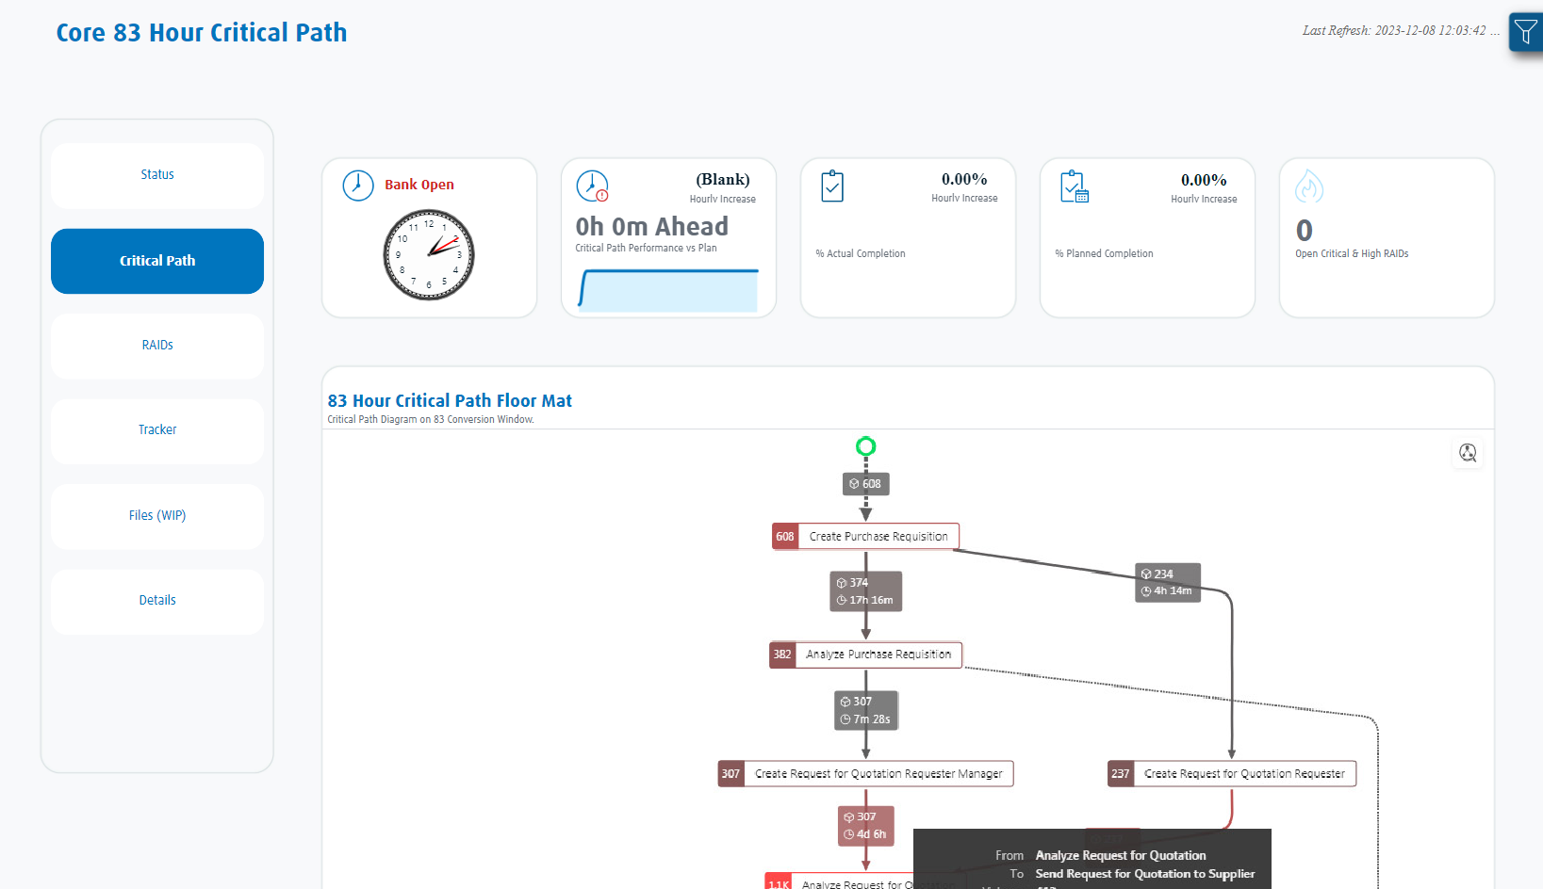
In the interest of clarity and confidentiality, the data presented herein is entirely fictitious and utilized solely for demonstration purposes

Slide 25
Playbook Model Design
Playbook View with Critical Path: Your flight manual for the pivotal merger weekend, directing the aircraft safely through potential storms.
Playbook Report
Stakeholders
Import Mode
Email Notifications
SharePoint Lists
w/ Power Apps Form
PBI Dataset
End Users
Notes:
Add the green, yellow

Slide 26
Book: Data Modeling - Alberto and Marco
Playbook
Playbook View with Critical Path: Your flight manual for the pivotal merger weekend, directing the aircraft safely through potential storms.
GitHub - deneb
Microsoft Appsource: Synoptic Panel

Slide 27



Sentiment Score
Averages
Max
Hourly Increase/Decrease
Social Media
Mention Count
% Negative
% Positive
Hourly Counts
Social Media Feed Integration: An inflight communication channel capturing real-time customer feedback post-merger, ensuring a passenger-first approach.
Word Cloud
Most Frequent Words used on Social Media

Slide 28
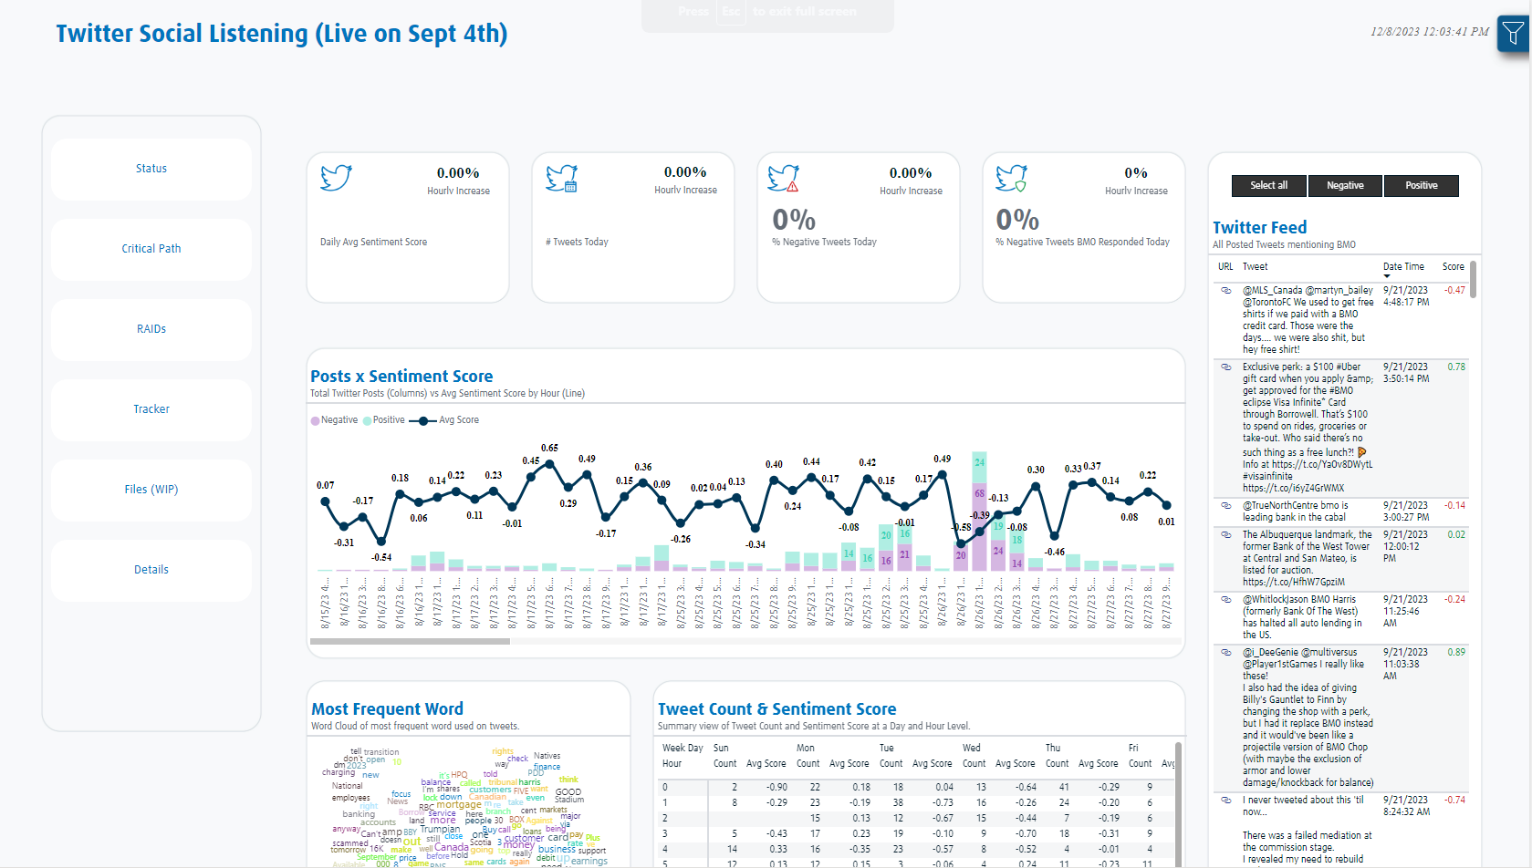

Slide 29
Social Model Design
Social Media Feed Integration: An inflight communication channel capturing real-time customer feedback post-merger, ensuring a passenger-first approach.
Social Media Report
Import Mode
Twitter APIs
Excel Files in SharePoint Folder
PBI Dataset
Notes:
Add the green, yellow

Slide 30
Classify text with BERT | Text | TensorFlow
Social Media
Social Media Feed Integration: An inflight communication channel capturing real-time customer feedback post-merger, ensuring a passenger-first approach.
Twitter API Documentation | Docs | Twitter Developer Platform
Tweepy Documentation — tweepy 4.14.0 documentation

Slide 31

Thank You!

